Slide 1
Binary tree

Slide 2
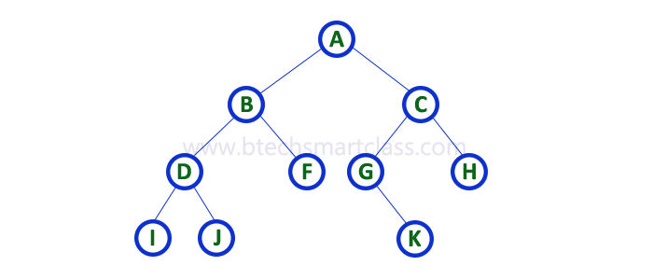
binary tree
binary tree is a non linear data structure it is also called as hierarchial data structure.

Slide 3
binary tree terms
binary tree each node has atmost 2 child nodes
top most node is called as root node eg)A(in diagram)
leaf nodes→the nodes which do not have childs eg)F,H,I,J,K
internal nodes→the node which has children is called as internal nodes eg)B,C,D,G

Slide 4
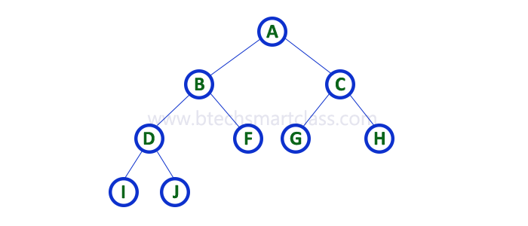
types of binary tree
strictly binary tree→the node which has zero or 2 children.it is also called as full binary tree

Slide 5
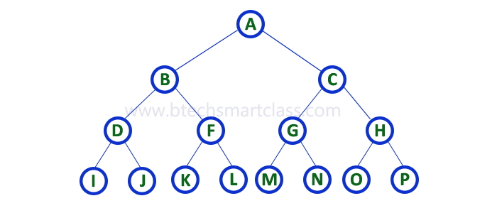
binary tree
complete binary tree→each node has exactly 2 children or zero children and all leafs are at same level.

Slide 6
Applications of tree
Manipulate hierarchical data.
2. Make information easy to search (see tree traversal).
3. Manipulate sorted lists of data.
4. As a workflow for compositing digital images for visual effects.
5. Router algorithms
6. Form of a multi-stage decision-making (see business chess).

Slide 7
Tree traversals
tree has different types of traversals
1)preorder traversal
2)inorder traversal
3)postorder traversal

Slide 8
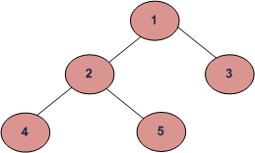
tree traversal
preorder
1)first look root
2)then left subtree
3)then right subtree
o/p 1,2,4,5,3

Slide 9
tree traversal
inorder
1)first look left subtree
2)then root
3)then right subtree
o/p:4,2,5,1,3

Slide 10
tree traversal
postorder
1)first look left subtree
2)then right subtree
3)then root
eg)4,5,2,3,1

Slide 11
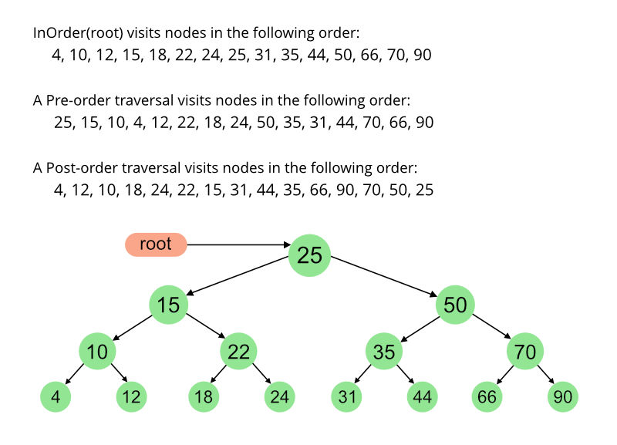

Slide 12
C implementation
#include<stdio.h>
#include<stdlib.h>
struct n
{
int data;
struct n *left;
struct n *right;
};
typedef struct n node;
node *root;

Slide 13
C implementation
void insert(node *temp,int data)
{
node *newnode;
if(temp->data>data&&temp->left!=NULL)
{
printf("travel left");
insert(temp->left,data);
}
else if(temp->data<data&&temp->right!=NULL)
{
printf("travel right");
insert(temp->right,data);
}

Slide 14
C implementation
newnode=(node*)malloc(sizeof(node));
newnode->data=data;
newnode->left=NULL;
newnode->right=NULL;
if(temp->data>data&&temp->left==NULL)
{
temp->left=newnode;
printf("inserted in left");
}
else if(temp->data<data&&temp->right==NULL)
{
temp->right=newnode;
printf("inserted in right");
} }

Slide 15
C implementation
void preorder(node *temp)
{
if(temp==NULL)
return;
printf("%d ",temp->data);
preorder(temp->left);
preorder(temp->right);
}

Slide 16
C implementation
void postorder(node *temp)
{
if(temp==NULL)
return;
postorder(temp->left);
postorder(temp->right);
printf("%d ",temp->data);
}

Slide 17
C implementation
void inorder(node *temp)
{
if(temp==NULL)
return;
inorder(temp->left);
printf("%d ",temp->data);
inorder(temp->right);
}

Slide 18
C implementation
int main(void)
{
int ch,data;
root=(node*)malloc(sizeof(node));
printf("Enter root node\n");
scanf("%d",&root->data);
root->left=NULL;
root->right=NULL;
while(1)
{
printf("1.insert 2.preorder 3.postorder 4.inorder 5.exit\n");
scanf("%d",&ch);

Slide 19
C implementation
switch(ch)
{
case 1: printf("enter data\n");
scanf("%d",&data);
insert(root,data);
break;
case 2:preorder(root);
break;
case 3:postorder(root);
break;
case 4:inorder(root);
break;
case 5:exit(0);
}
}}

Slide 20
Java Implementation
import java.util.*;
class node
{
int data;
node left;
node right;
node(int x)
{
data=x;
left=null;
right=null;
}
}

Slide 21
Java implementation
public class binarytree {
public void insert(node temp,int data)
{
if(temp.data>data&&temp.left!=null)
{
System.out.println("travel left");
insert(temp.left,data);
}
else if(temp.data<data&&temp.right!=null)
{
System.out.println("travel right");
insert(temp.right,data);
}

Slide 22
Java implementation
node newnode=new node(data);
if(temp.data>data&&temp.left==null)
{
temp.left=newnode;
System.out.println("inserted in left");
}
else if(temp.data<data&&temp.right==null)
{
temp.right=newnode;
System.out.println("inserted in right");
}
}

Slide 23
Java implementation
public void preorder(node temp)
{
if(temp==null)
return;
System.out.println(temp.data);
preorder(temp.left);
preorder(temp.right);
}

Slide 24
Java implementation
public void postorder(node temp)
{
if(temp==null)
return;
postorder(temp.left);
postorder(temp.right);
System.out.println(temp.data);
}

Slide 25
Java implementation
public void inorder(node temp)
{
if(temp==null)
return;
inorder(temp.left);
System.out.println(temp.data);
inorder(temp.right);
}

Slide 26
Java implementation
public static void main(String d[])
{
int data;
binarytree x=new binarytree();
Scanner in=new Scanner(System.in);
System.out.println("Enter root node value");
data=in.nextInt();
node root=new node(data);
while(true)
{
System.out.println("1.insert 2.preorder 3.inorder 4.postorder 5.exit");
int ch=in.nextInt();

Slide 27
java implementation
switch(ch)
{
case 1:System.out.println("Enter the node to insert");
data=in.nextInt();
x.insert(root,data);
break;
case 2:x.preorder(root);
break;
case 3:x.inorder(root);
break;
case 4:x.postorder(root);break;
case 5:System.exit(0);
}
}
}
}

